Slide 1

High Frequency Amplifier
Quantum Syntax

Slide 2
Specifications
Supply voltage: 12V
Transistors used: BC547,TIP31C,TIP32C
Input Siganal:0.1 V sine wave
Frequency range of the input: (20-100) kHz
Output Load: 8 ohm speaker

Slide 3
Block Diagram
Input Signal
(0.1 V sine wave)
Pre-Amplifier
(BJT in CE configuration)
Power Amplifier
(Class AB)
Output Siganl
(Through 8 ohm speaker)

Slide 4
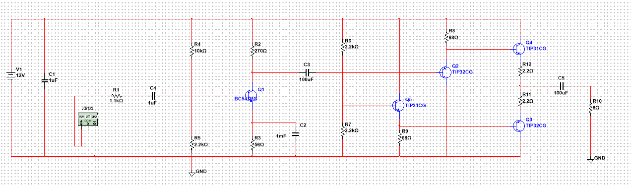
Circuit Diagram

Slide 5
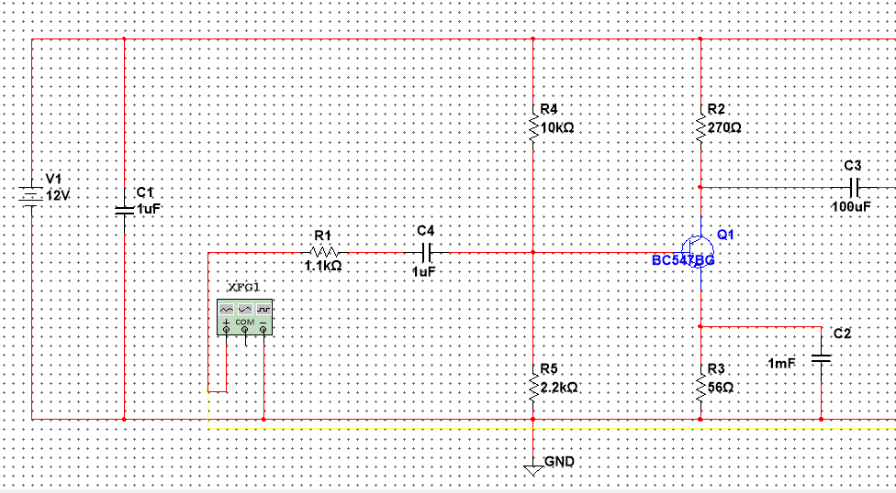
Stage One - Voltage Amplifier

Slide 6
Purpose: Since the noise effect will be very strong for tiny amplitudes the input sine wave’s amplitude should be increased first. For this, a voltage amplifier is used as pre Amplifying stage
The common emitter configuration : provides the largest power gain
BC547 transistor : has a high transition frequency and can provide a high current gain that is stable with collector current and temperature.

Slide 7
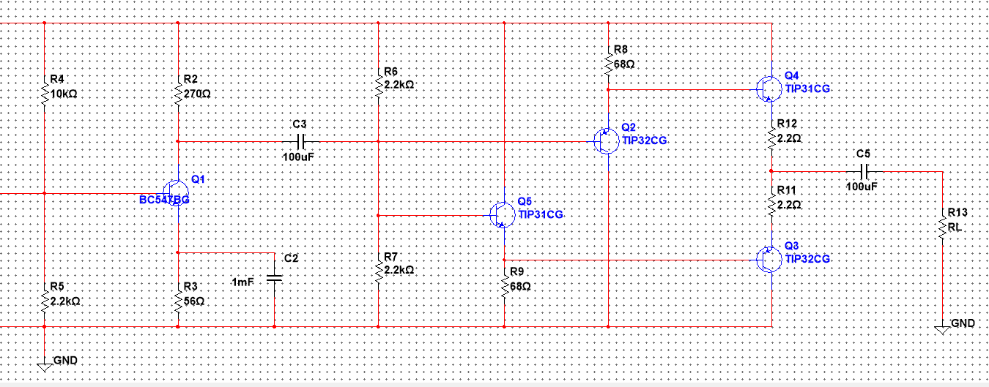
Stage two - Power Amplifier

Slide 8
Purpose:The preamplifier had a considerable power gain, but we still needed to increase it to provide distortion free, pure output when used with an 8 Ω resistance speaker.
Class AB : efficient than class A and has less crossover distortion than class B.
Biasing : The two base-emitter junctions of the power amplifier transistors are forward biased using common collector transistors.
TIP31C/ TIP32C transistors : complementary symmetry pair for AB class operation, have high Gain Bandwidth product.

Slide 9
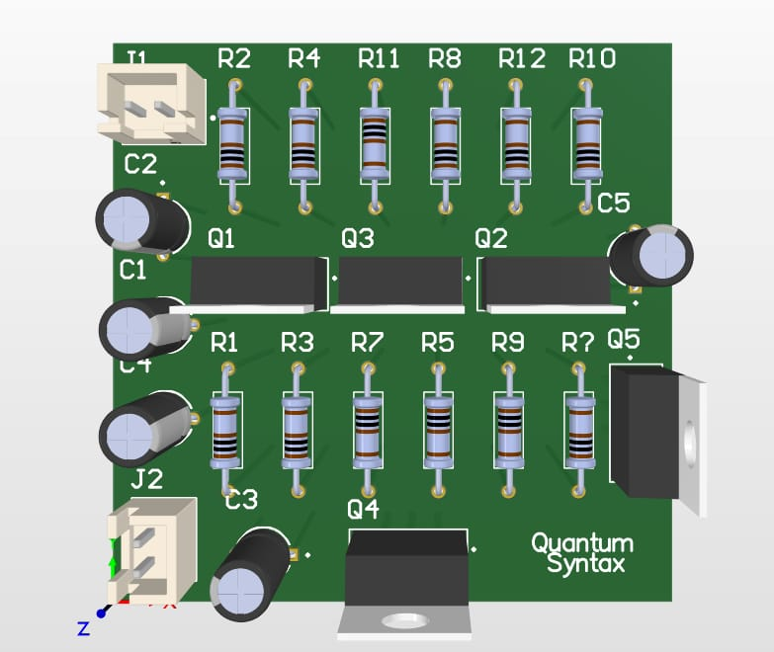
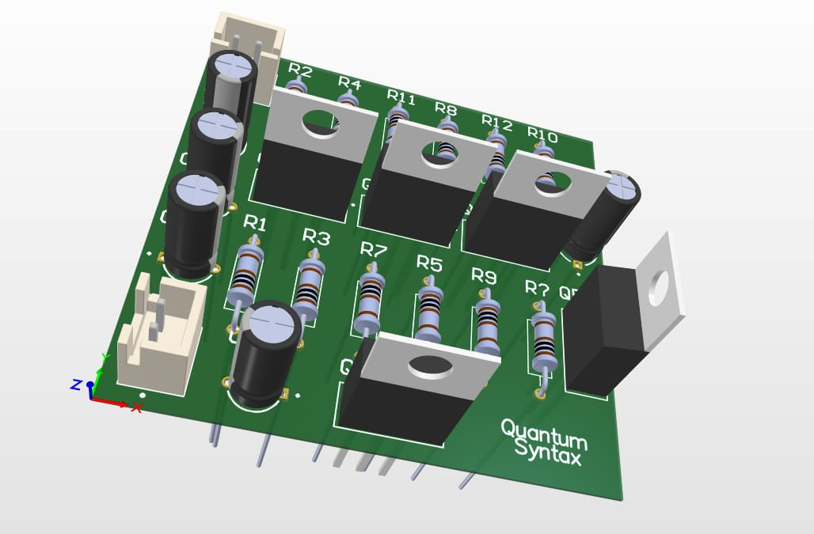
PCB design

Slide 10
Enclosure design

Slide 11
Testing

